Slide 1
Understanding basic ideas of RSST
Atsushi Kawabata

Slide 2
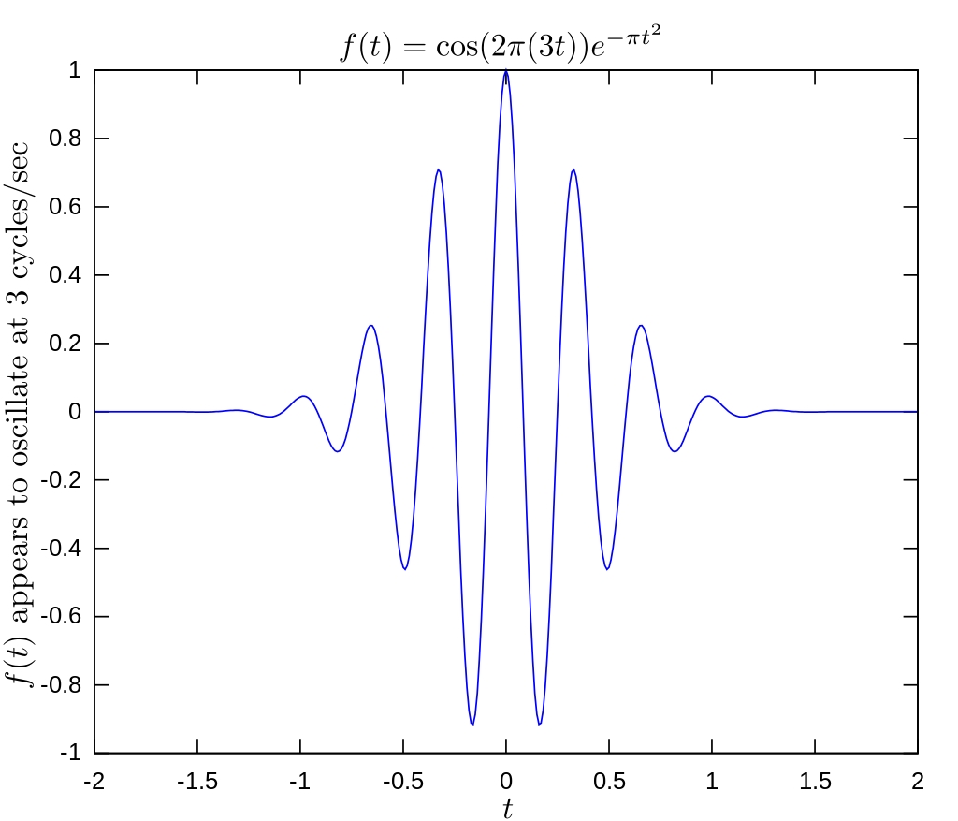
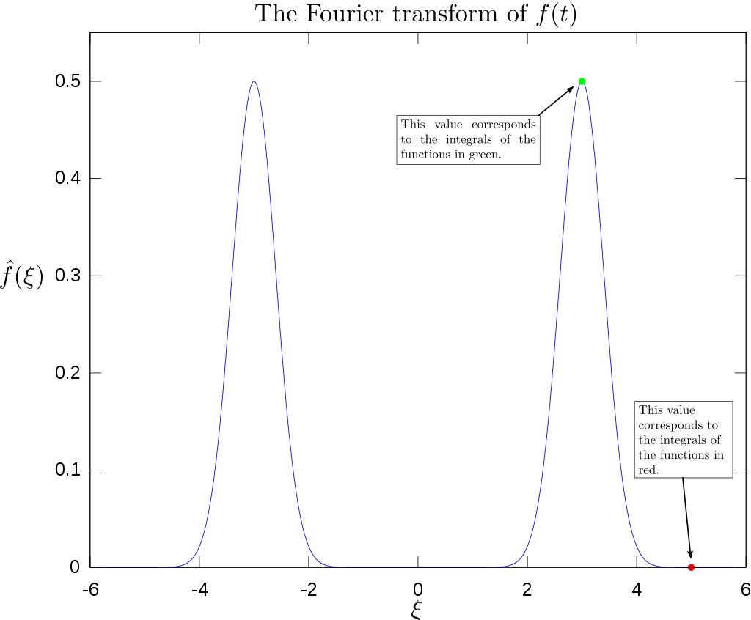

Fourier Transformation (FT) [1]
https://en.wikipedia.org/wiki/Fourier_transform
Converts time information to frequency information
Useful because any waves expressed as superposition of sine and cosine with different frequencies
$F\left(ω\right)=\int_{−∞}^{∞}{f\left(t\right)e^{−iωt}}dt$

Slide 3
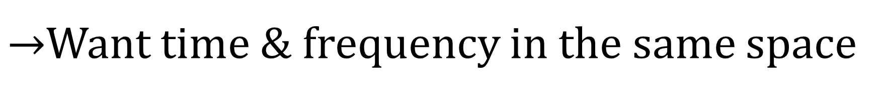
Problem with the FT
Useful b/c any waves expressed as superposition of sin and cos w/ different frequencies = All the time information is lost after the FT
Time information and frequency information are in two different spaces. After FT, they are two completely unrelated information.
$→$Want time & frequency in the same space

Slide 4
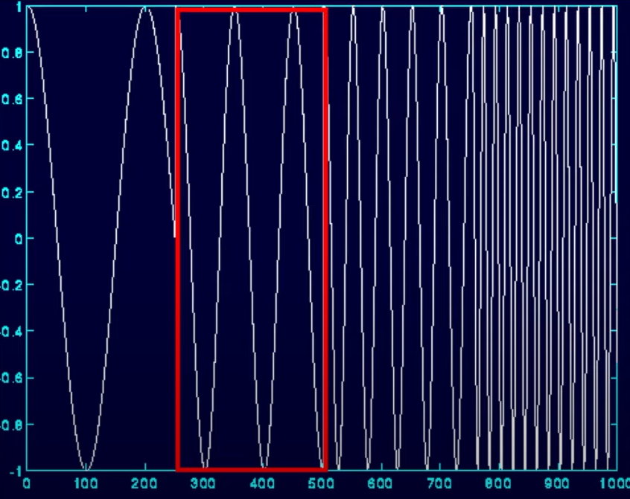
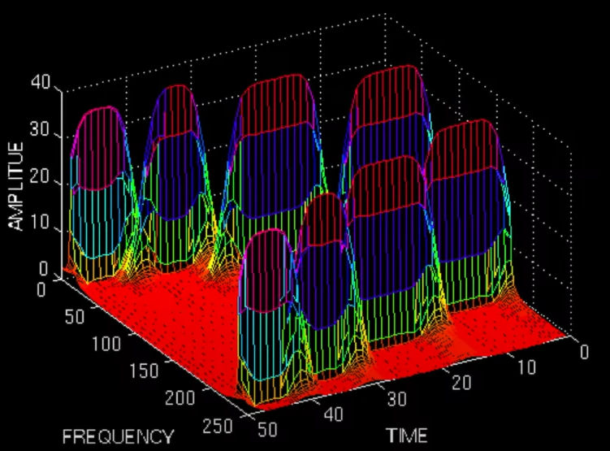

Short-Time Fourier Transformation (STFT)
https://www.youtube.com/watch?v=kuuUaqAjeoA
Evenly divide time into time regions and perform FT for each time region
$F\left(τ, ω\right)=\int_{−∞}^{∞}{f\left(t\right)w(t−τ)e^{−iωt}}dt$
$w(t−τ)$is called the window function

Slide 5
Problem with the STFT
Uncertainty Principle: Tight time region gives wide frequency region, wide time region gives tight frequency region
Tight time region have better resolution for high-frequency waves than low-frequency waves
Wide time region have better resolution for low-frequency waves than high-frequency waves

Slide 6
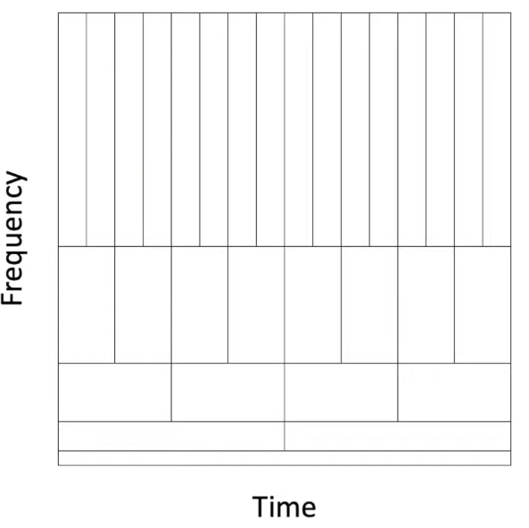
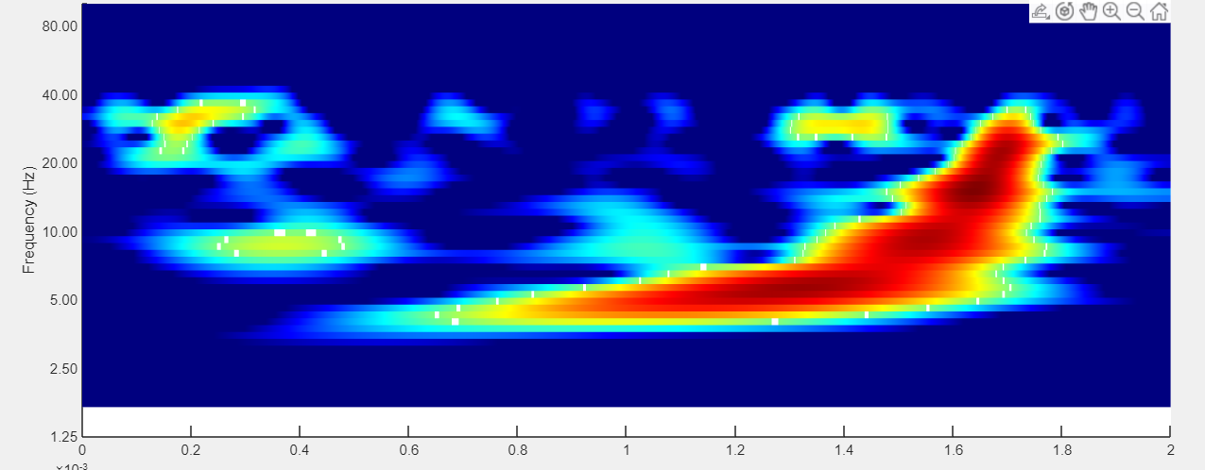
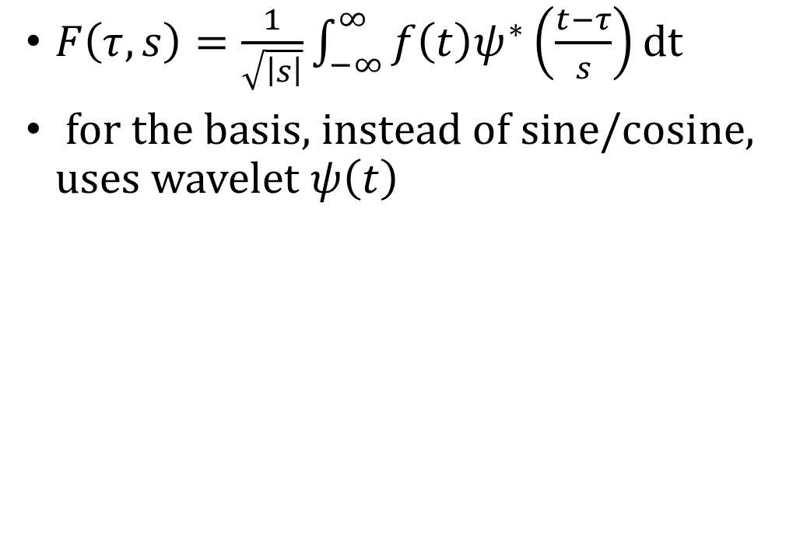
Continuous Wavelet Transformation (CWT)
https://www.youtube.com/watch?v=kuuUaqAjeoA,
Gw-openscience.org/GW150914data/P150914/fig1-observed-H.txt
At high-frequency range, transforms with tight time region, at low-frequency range, transforms with wide time region.
$F\left(τ, s\right)=\frac{1}{\sqrt{\left|s\right|}}\int_{−∞}^{∞}{f\left(t\right)ψ^{∗}\left(\frac{t−τ}{s}\right)}dt$
for the basis, instead of sine/cosine, uses wavelet $ψ\left(t\right)$

Slide 7
Problem with the CWT
The uncertainty of time and frequency makes it hard to acquire information

Slide 8
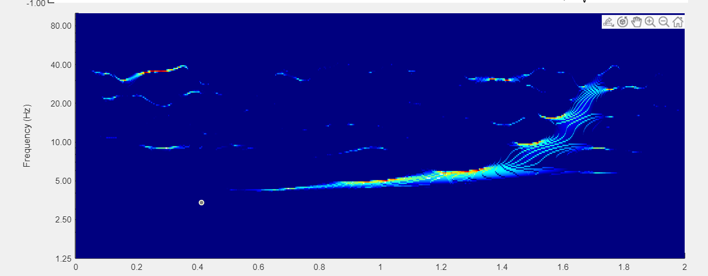

Synchro-squeezed Wavelet Transformation (SSWT)
Gw-openscience.org/GW150914data/P150914/fig1-observed-H.txt
“Squeeze” the regions.
$T_{s}\left(τ, ω\right)=\int_{A\left(τ\right)}{F\left(τ,s\right)s^{−\frac{3}{2}}δ\left(ω\left(a,b\right)−ω\right)}ds$
$$where A\left(τ\right)=\left\{s;W_{s}\left(τ,s\right)≠0\right\}$$

Slide 9
Problem with the SSWT
Must choose the appropriate wavelet
Gabor wavelets are most commonly used, b/c they have the least time-frequency uncertainty
What is Gabor wavelet and why?
Symmetric, non-orthogonal basis
Still no physical interpretation

Slide 10
What is “Amplitude”?
Each of the transformation spills out “amplitude information” and “phase information” because the result is in complex numbers.
In neuroscience, “amplitude information” and “phase information” are usually plotted in different graphs, i.e. spaces, as power spectrum and phase spectrum.
So, the time-frequency-amplitude graph usually is a time-graph-power graph.
Look at the amplitude and phase on the same graph by looking at real part only: RSWT

Slide 11
Real-part-only Continuous Wavelet Transformation (RCWT)
Real-part-only Synchro-squeezed Wavelet Transformation (RSWT) is acquired by synchro-squeezing RCWT.

Slide 12
Physical interpretation of RSWT
Potential
Power

Slide 13
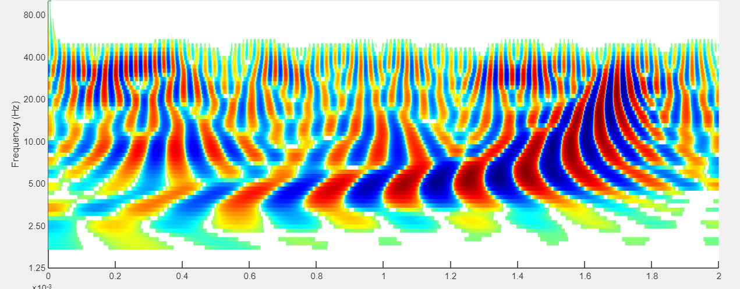
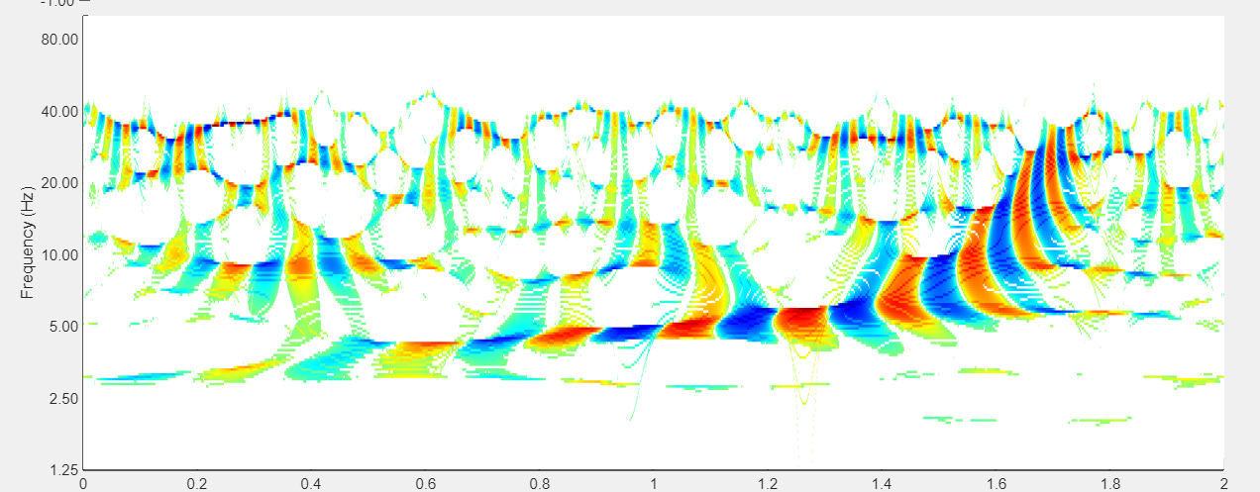
Gravitational Wave
Gw-openscience.org/GW150914data/P150914/fig1-observed-H.txt
CWT
SSWT
RCWT
RSWT

Slide 14
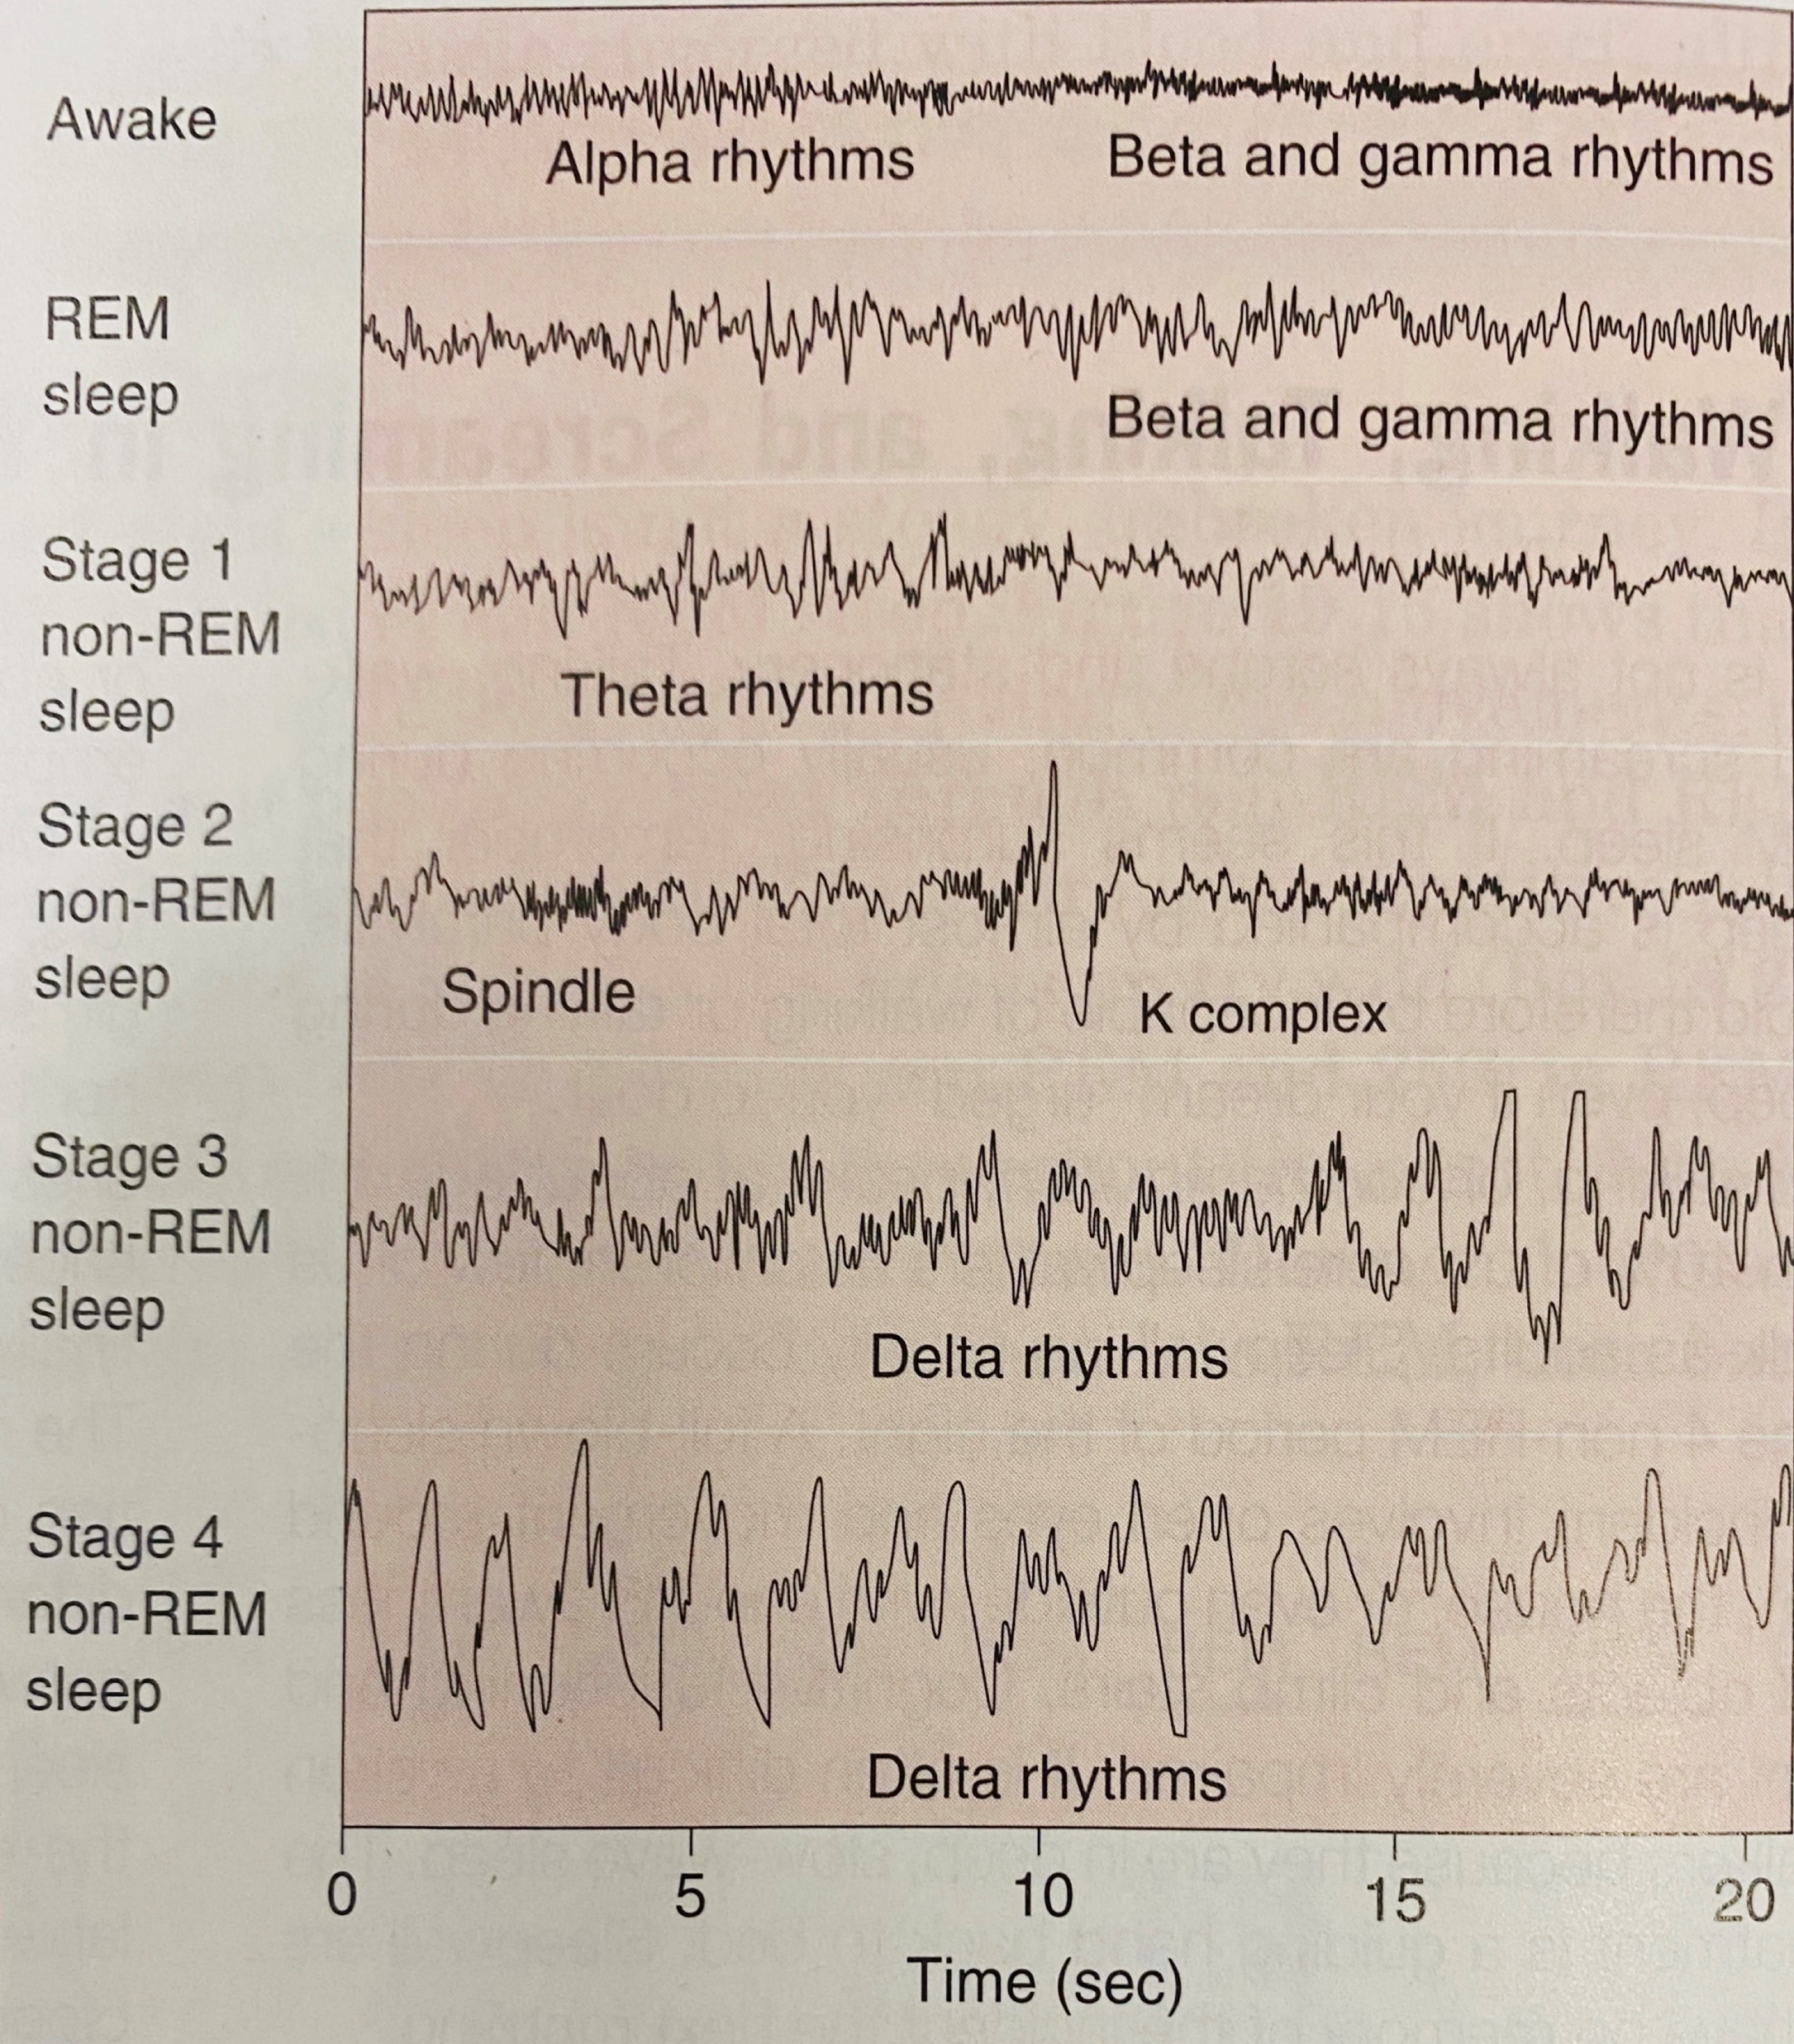
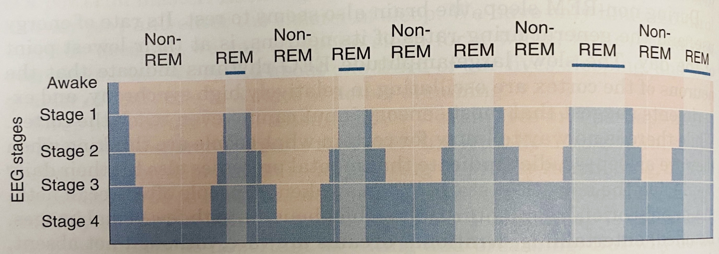
NREM and REM sleep
“Neuroscience Exploring the Brain”. Bear, Connors, Paradiso. 4th edition, Ch.19.
NREM sleep: “an idling brain in a movable body”
REM sleep: “an active, hallucinated brain in a paralyzed brain”

Slide 15
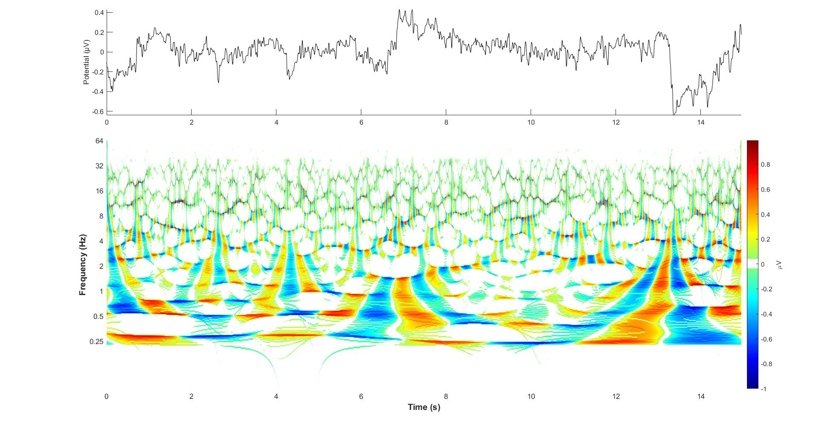
Stage 0 (Wake) RWST
Acharya 2015

Slide 16
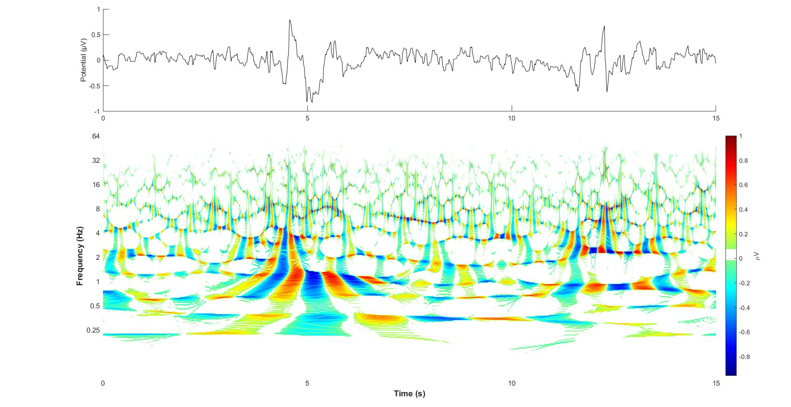
REM RWST
Acharya 2015

Slide 17
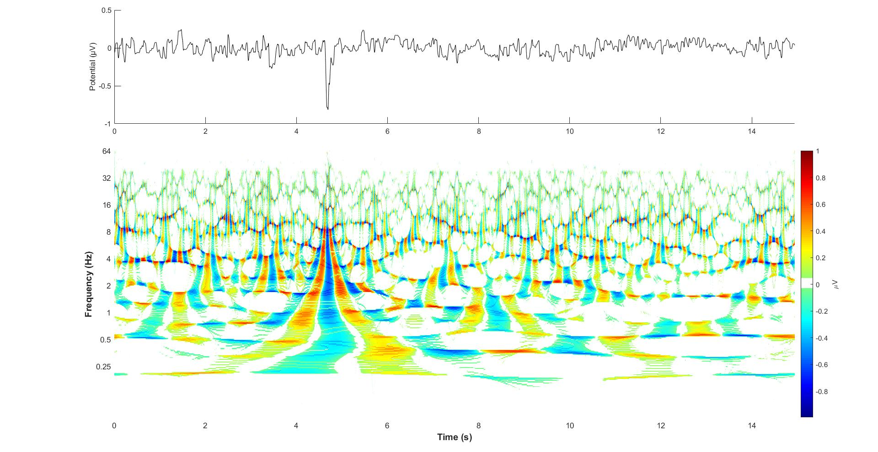
Stage 1 (Drowsiness) RWST
Acharya 2015

Slide 18
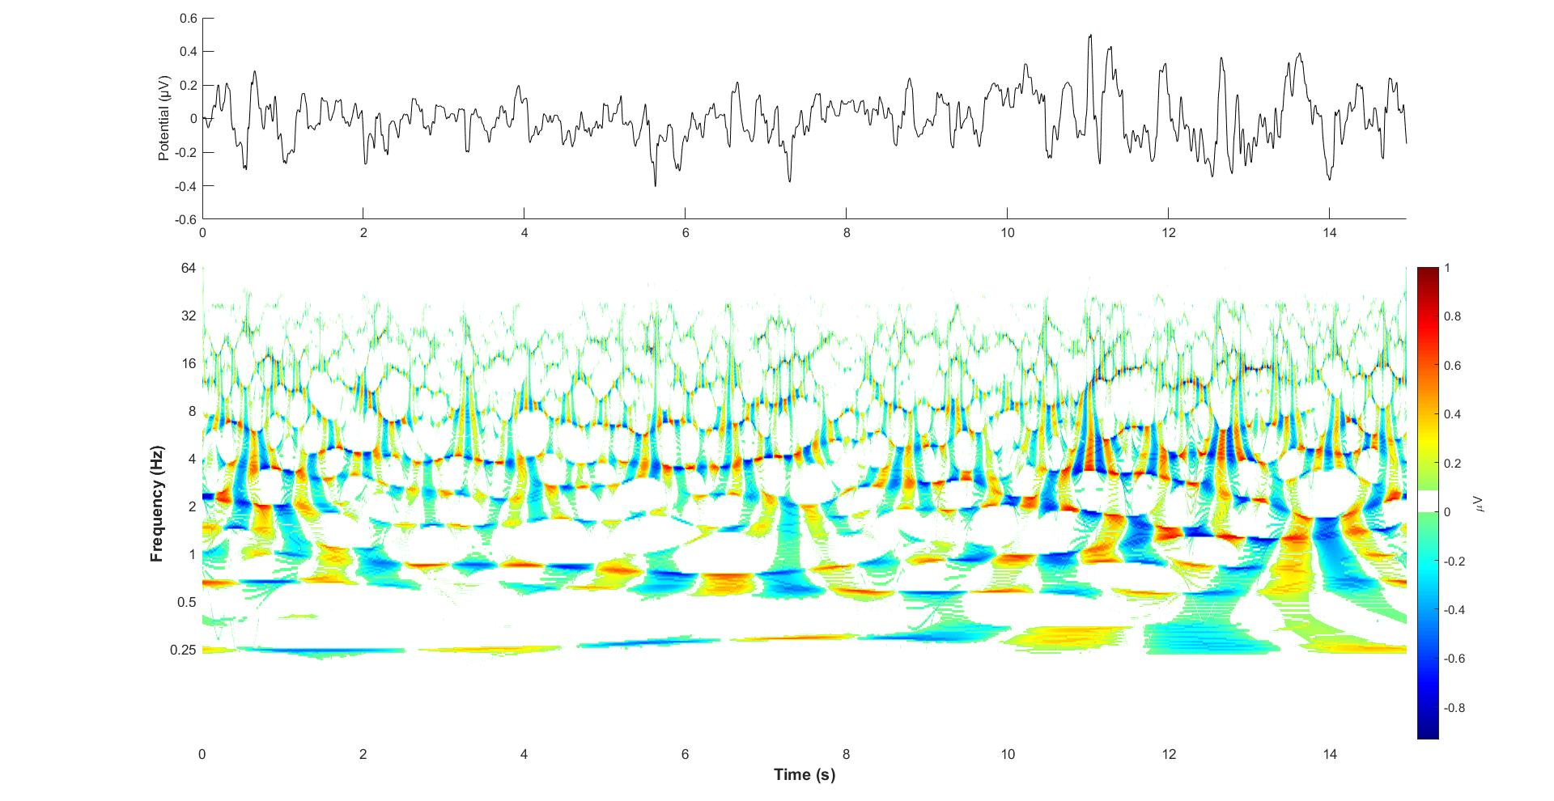
Stage 2 (light sleep) RWST
Acharya 2015

Slide 19
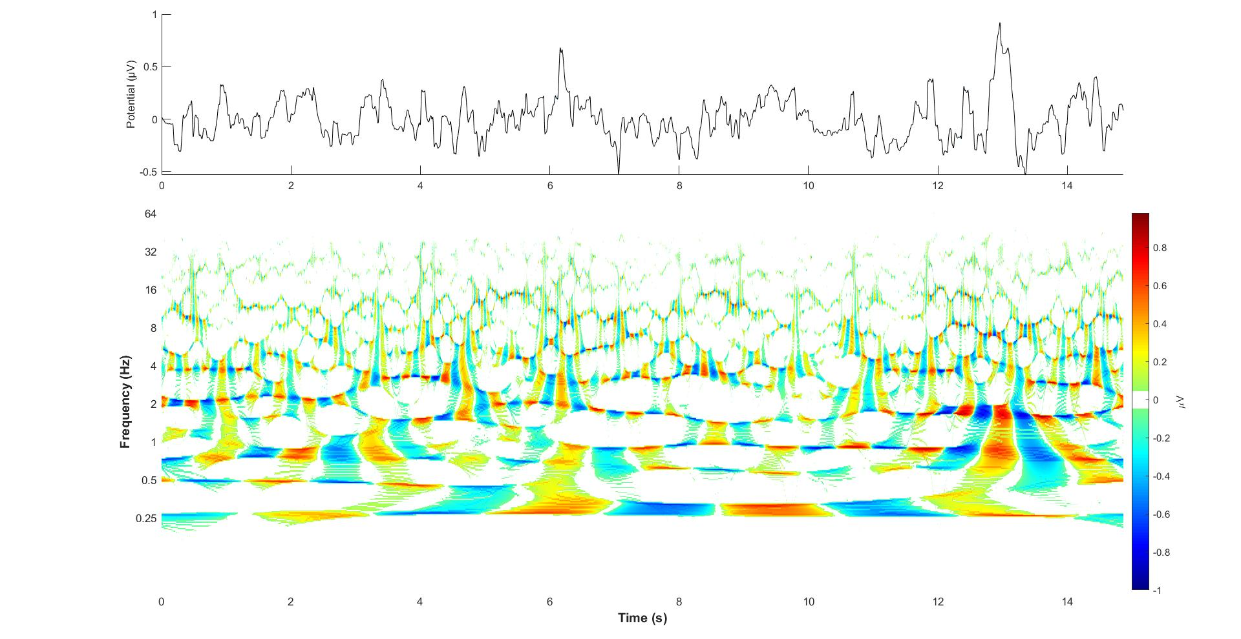
Stage 3 (deep sleep) RWST
Acharya 2015

Slide 20
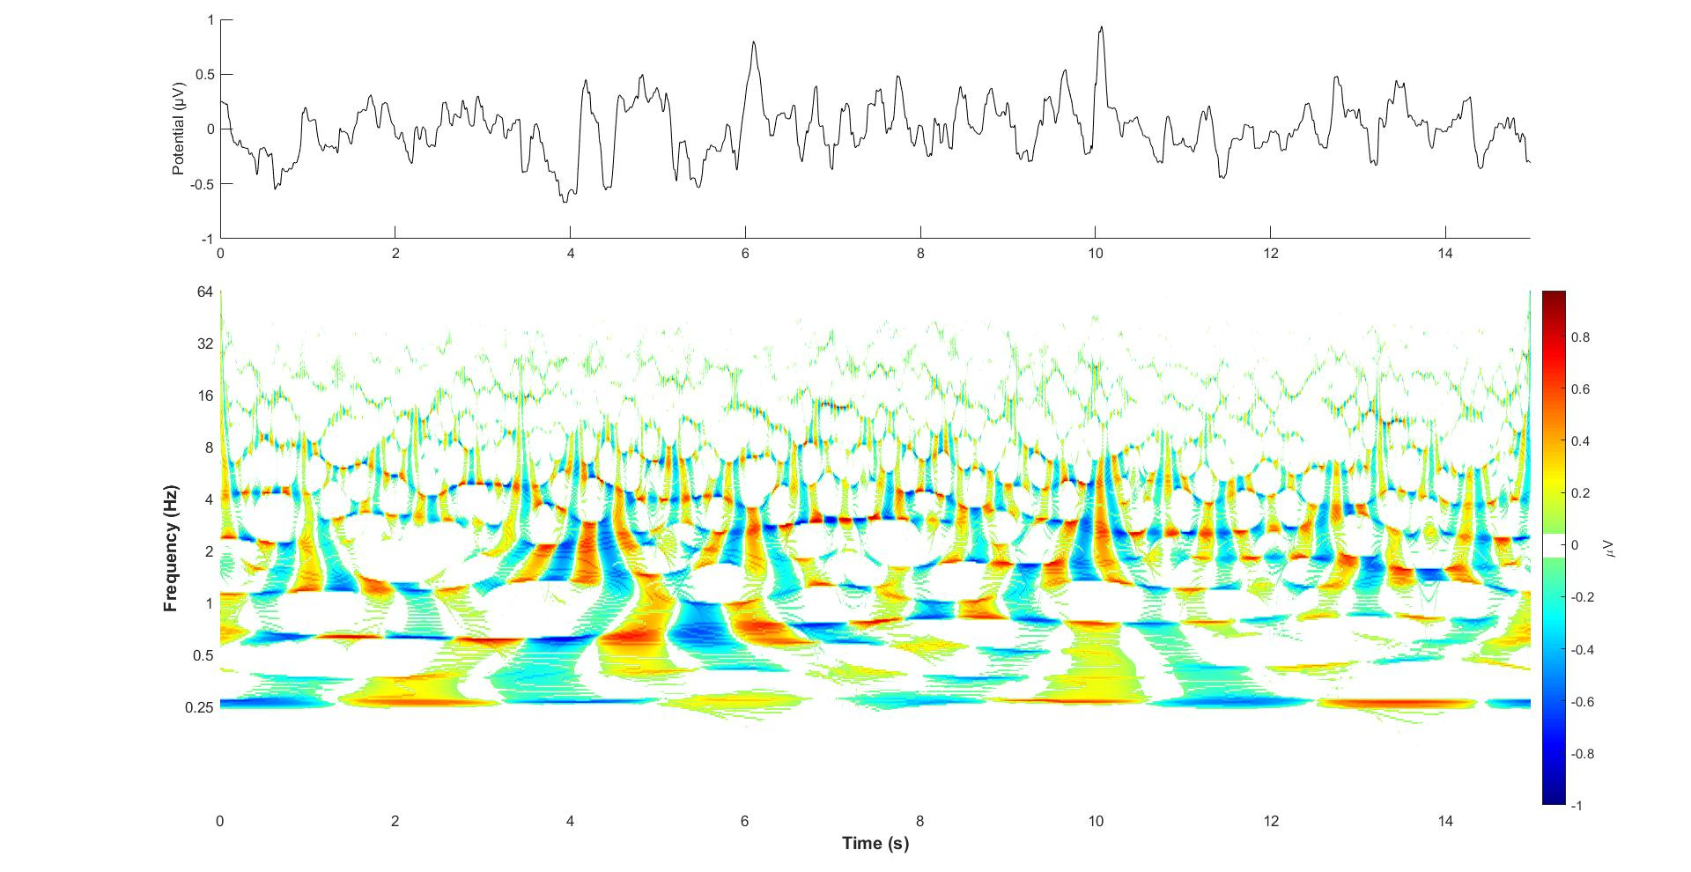
Stage 4 (deep slow wave) RWST
Acharya 2015

Slide 21
Function of 1.25 Hz, 2.5 Hz-band
1.25 Hz and 2.5 Hz band can be seen on all the RSWT
2.5 Hz could be associated with language
1.25 Hz could be associated with unconsciousness

Slide 22
Investigation of Hyperspace
The navigation, sensory of the space (the outer world) is done at frequencies >~5 Hz
The “navigation”, “sensory” of the “hyperspace” (the inner world) is done at frequencies <~2.5 Hz

